Slide 1
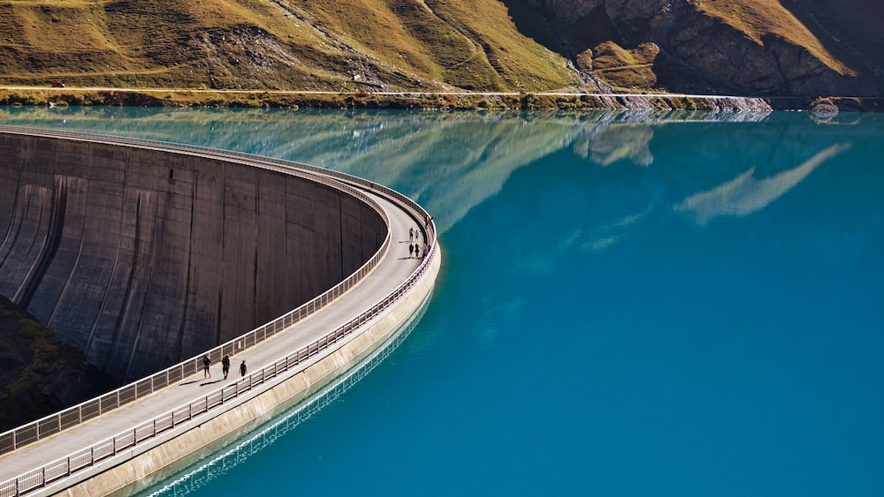

Diamer-Bhasha Dam Engineering Project Management
Presented by
Muhammad Ahmed Mohsin
Muhammad Bilal
Muhammad Ahmed Usman
Muhammad Ali Afridi
Muhammad Ali Farooq

Slide 2
Outline
Introduction and Overview
Budgeting
The Significance and Need
Comparison with Kalabagh Dam
Conclusion

Slide 3
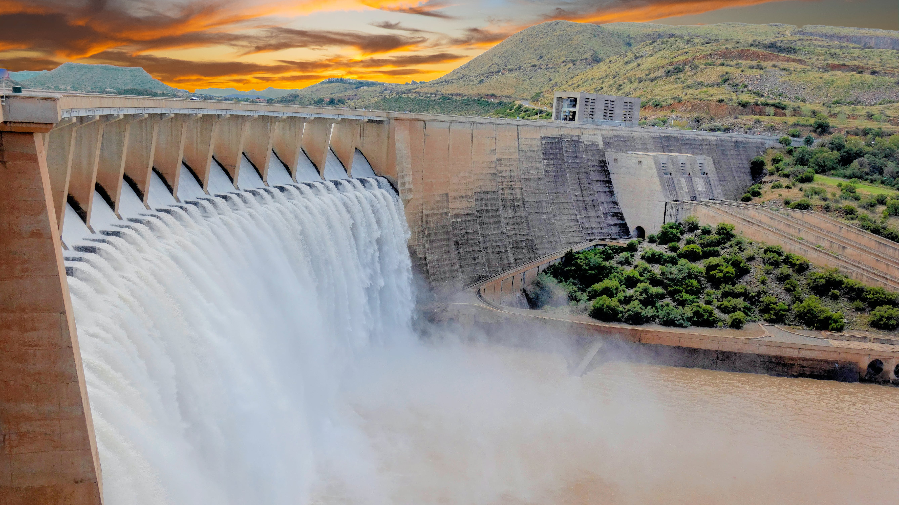
Introduction and Overview

Slide 4
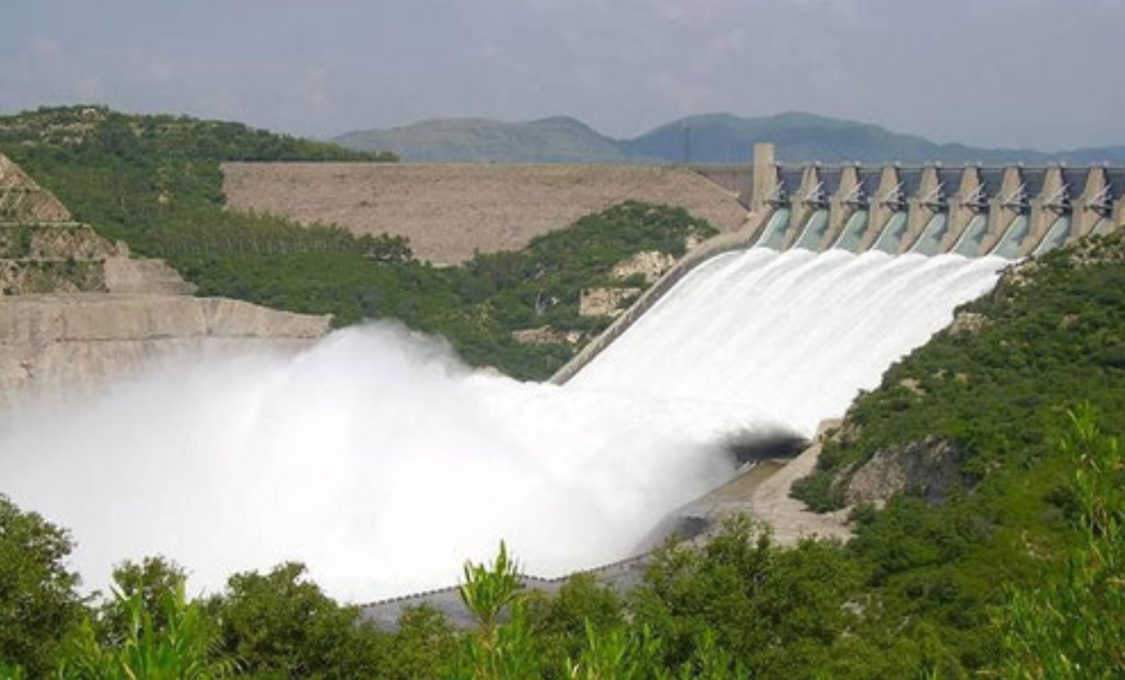
Introduction
Water Management: Dams store water for reliable agricultural, industrial, and domestic supply.
Flood Control: Dams regulate river flow, preventing downstream floods during heavy rainfall.
Hydropower Generation: Dams harness water's energy for sustainable and renewable electricity.
Recreation and Tourism: Dams create reservoirs for leisure activities, attracting tourists and boosting local economies.

Slide 5
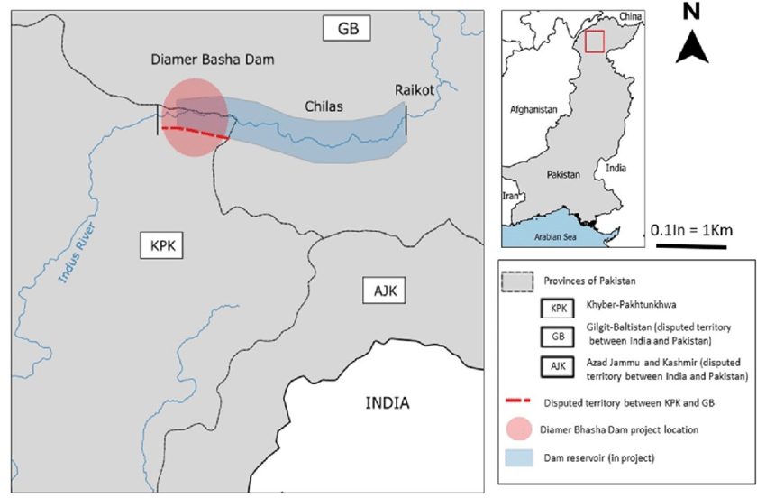
Location
Diamer-Bhasha Dam is a concreted-filled gravity dam, in the preliminary stages of construction, on the River Indus between Kohistan district in Khyber Pakhtunkhwa and Diamer district in Gilgit Baltistan, Pakistan administered Kashmir.

Slide 6
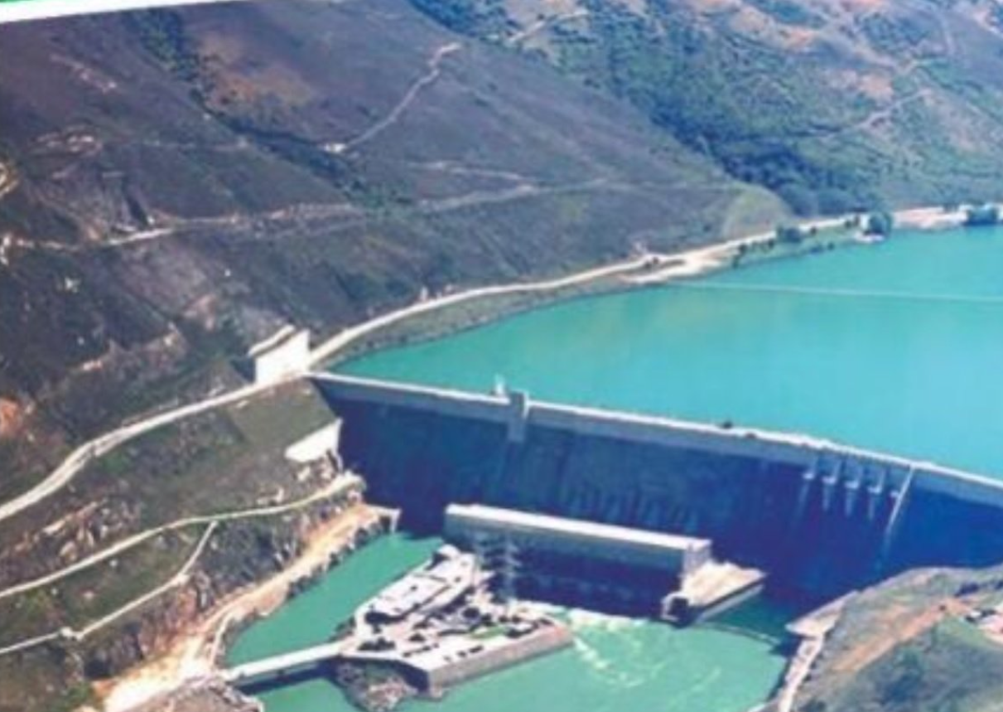
Location
The dam site is situated near a place called "Bhasha", hence the name which is 40 km downstream of Chilas town and 315 km from Tarbela Dam.
The eight million acre feet (MAF) reservoir with 272-metre height will be the tallest roller compact concrete (RCC) dam in the world.

Slide 7
Electricity Generation
The dam will impound 15% of the annual river flow.
The dam project would cover an area of 110 km² and extend 100 km upstream of the damsite up to Raikot Bridge on Karakoram Highway .
Two underground powerhouses are being proposed, one on each side of the main dam having six turbines on each side with a total installed capacity of 4500 MW

Slide 8
Cost
The cost of the Diamer-Bhahsa dam is $ 13.87 billion with 8 years completion time.
A huge amount of Rs 27.824 billion is required for the acquisition of land and resettlement of the people to be affected in the wake of the construction of the dam.
Under the proposed project, Rs 10.76 billion will be spent for the acquisition of agriculture-barren land, tree and nurseries and Rs 1.638 billion to be utilised for properties & infrastructure.
Rs 8.8 billion for establishment of nine model villages, Rs 62.119 million for pay & allowances for administrative arrangements, and Rs.17-7 million for contingent administrative expenses.

Slide 9
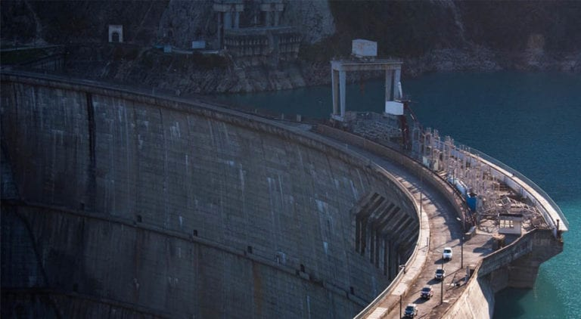
Need for Diamer-Bhasha Dam?

Slide 10
Major Objectives
Water Security
Reforestation of barren lands
Generate 4500 MW Electricity
10.5 km³ water for irrigation & drinking
Additional 7.9 km³ for low flow periods
Prolong lifespan of Tarbela Dam by 35 years
Mitigate damage during floods

Slide 11
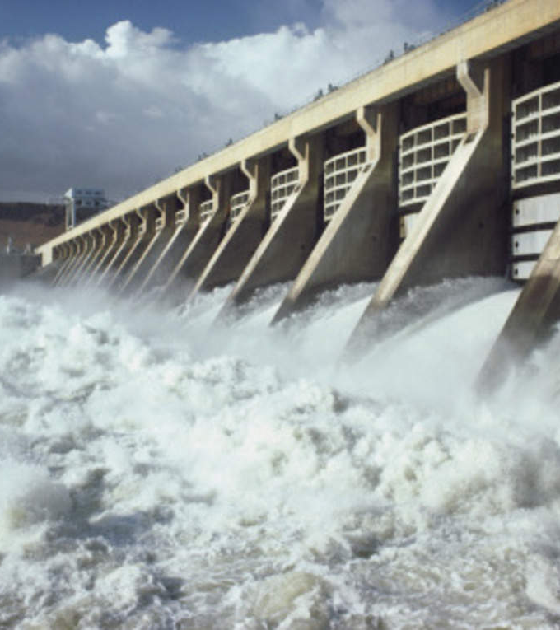
Additional Expected Outcomes
Short and Long-Term Employment (15000 jobs)
Infrastructure leading to socio-economic uplift

Slide 12
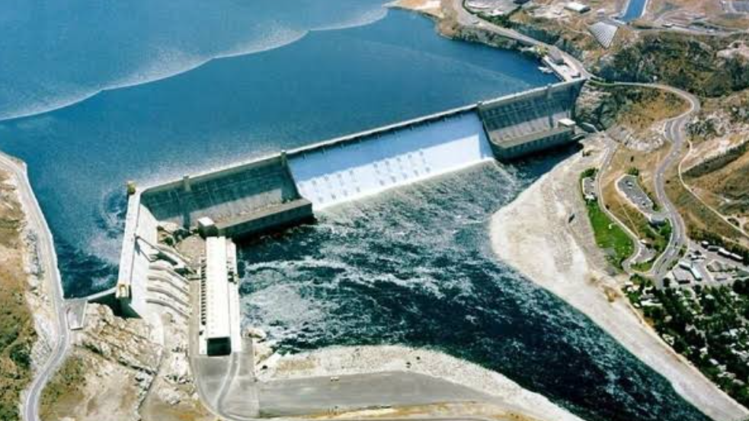
Bhasha dam is no substitute for Kalabagh dam not because of its altitude which is high enough, but because no irrigation canals can be taken out from it because of the hilly terrain. No canals can be taken out from any dam on the Indus except from Kalabagh Dam. KP Chief Minister Shamsul Mulk

Slide 13
Comparison with Kalabagh Dam

Slide 14
Diamer-Bhasha Vs Kalabagh Dam
Technical Specifications:
Diamer Bhasha Dam: Concrete-filled gravity dam, 272 meters tall, 8.1 million acre-feet storage capacity, 4,500 MW power generation.
Kalabagh Dam: Earth-fill dam, 260 meters tall, 6.1 million acre-feet storage capacity, 3,600 MW power generation.
Benefits:
Diamer Bhasha Dam: Higher power generation, flood mitigation downriver, additional water storage for irrigation.
Kalabagh Dam: Lower construction cost, utilizes more rivers, flood mitigation across Punjab and Sindh, inter-province water transfer and sharing.
Challenges:
Diamer Bhasha Dam: Higher construction cost, complex terrain, resettlement of local communities, environmental concerns in sensitive region.
Kalabagh Dam: Political controversy and inter-provincial water sharing disputes, earthquake prone region, potential impact on Indus dolphins.
Current Status:
Diamer Bhasha Dam: Under construction, estimated completion in 2028.
Kalabagh Dam: Still in the planning stage, facing political and social hurdles.

Slide 15
Problems with Diamer-Bhasha Dam

Slide 16
Problems
Financial Complexity:
Estimated costs surged from $14 billion to PKR1.497 trillion.
Concerns arise regarding financial feasibility and management.
History of Funding Challenges:
Failed attempts at securing funding from World Bank and ADB.
Crowdfunding efforts fell short, signaling financial instability.
Geopolitical Friction:
India's consistent objections hamper diplomatic relations.
China-Pakistan cooperation countered by India's protests.

Slide 17
Problems
Local Concerns and Displacement:
Downstream impact worries in Sindh spark opposition.
Unequal benefits distribution in Gilgit-Baltistan triggers debates.
Environmental & Social Impacts:
Potential displacement of thousands and flooding risks.
Threats to ancient rock carvings and water shortages in neighboring regions.
Debt and Vulnerability:
Rising hydro debt raises concerns about foreign interference.
Pakistan's financial vulnerability due to large-scale hydropower investments.

Slide 18
Diamer-Bhasha Dam Success Determination

Slide 19
Project Success Determination
Time | Budget
Diamer Bhasha Dam is expected to be completed by 2028. Although this could change depending on various factors and delays. | The initial feasibility report in 2008 estimated the total cost of the project at US$12.6 billion The most recent estimates, as of 2023, suggest a total cost of around US$14 billion. This includes financing charges and other contingencies.
Performance | Social Acceptance
Estimated capacity: 4,500 MW, enough to meet the energy needs of millions of people. Annual energy production: 18,100 GWh, providing a reliable source of clean hydropower. | Mixed, with praise for convenience and criticism of cost and land. Supporters see the dam as a vital solution to Pakistan's chronic energy and water problems.Critics express concerns about the project's high cost and potential financial burden

Slide 20
Conclusion

Slide 21
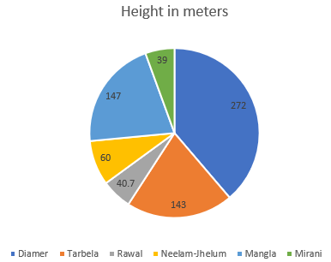
Concluding with Development Details
Size Margin
A part of the Water Vision 2025 presented by WAPDA in July 2001
It is the biggest ever dam project undertaken in Pakistan. Standing 272m-tall

Slide 22

Controversy
Remained in limbo for a long time due to the non-availability of funds
Drawn controversy because of its location in Gilgit Baltistan, a disputed territory between India and Pakistan
US and global financial institutions requesting not to fund any infrastructure project in the PoK
Situated near the Himalayan peak Nanga Parbat, the dam project is also alleged to be in a high seismic zone
Project has also triggered significant local resistance, as it is estimated to displace more than 4,200 families in nearby areas

Slide 23

Details Continued
CPEC Part: The initiative received fresh impetus with the inauguration of China’s Belt and Road Initiative (BRI) in 2017
Fund Raising: The Chief Justice of Pakistan initiated a crowd-funding campaign for the Diamer Bhasha Dam Project in October 2018
CPEC Retrieval: Pakistan, however, withdrew the Diamer Bhasha Dam from the CPEC projects list in 2018, due to China’s strict monetary conditions
Expected Completion Year: 2028

Slide 24


Questions?

